Slide 1
Socket Programming
connecting processes

Slide 2
Overview
Introduction to Sockets
A generic Client-Server application
Programming Client-Server in C
Programming Client-Server in Java

Slide 3
Introduction to Sockets

Slide 4
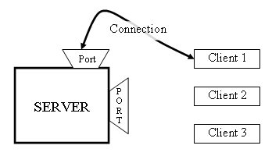
Introduction to Sockets
Why Sockets?
  Used for Interprocess communication.
The Client-Server model
  Most interprocess communication uses client-server model
  Client & Server are two processes that wants to communicate with each
  other
  The Client process connects to the Server process, to make a request for
  information/services own by the Server.
  Once the connection is established between Client process and Server
  process, they can start sending / receiving information.
What are Sockets?
  End-point of interprocess communication.
  An interface through which processes can
  send / receive information
Socket

Slide 5
Introduction to Sockets
What exactly creates a Socket?
  <IP address, Port #> tuple
What makes a connection?
  {Source<IP address, Port #> , Destination <IP address, Port #>} i.e. source socket – destination socket pair uniquely identifies a connection.
Example
Client
1343
Server
192.168.0.2
80
Client
1343
192.168.0.1
192.168.0.3
Client
5488
192.168.0.2

Slide 6
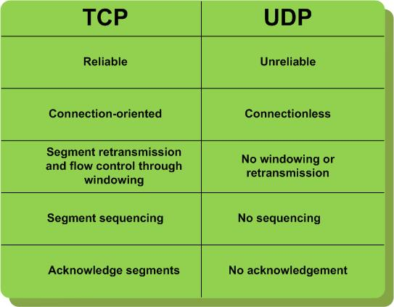
TCP vs. UDP

Slide 7
Introduction to Sockets
Socket Types
  STREAM – uses TCP which is reliable, stream oriented protocol
  DATAGRAM – uses UDP which is unreliable, message oriented protocol
  RAW – provides RAW data transfer directly over IP protocol (no transport layer)
Sockets can use
  “unicast” ( for a particular IP address destination)
  “multicast” ( a set of destinations – 224.x.x.x)
  “broadcast” (direct and limited)
  “Loopback” address i.e. 127.x.x.x

Slide 8
A generic Client-Server application

Slide 9
A generic TCP application
algorithm for TCP client
  Find the IP address and port number of server
  Create a TCP socket
  Connect the socket to server (Server must be up and listening for new requests)
  Send/ receive data with server using the socket
  Close the connection
algorithm for TCP server
  Find the IP address and port number of server
  Create a TCP server socket
  Bind the server socket to server IP and Port number (this is the port to which clients will connect)
  Accept a new connection from client
    returns a client socket that represents the client which is connected
  Send/ receive data with client using the client socket
  Close the connection with client

Slide 10
Programming Client-Server in C

Slide 11
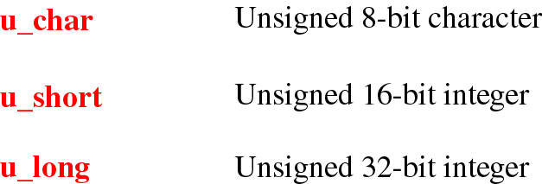
Data Types
int8_t signed 8-bit integer
int16_t signed 16-bit integer
int32_t signed 32-bit integer
uint8_t unsigned 8-bit integer
uint16_t unsigned 16-bit integer
uint32_t unsigned 32-bit integer

Slide 12
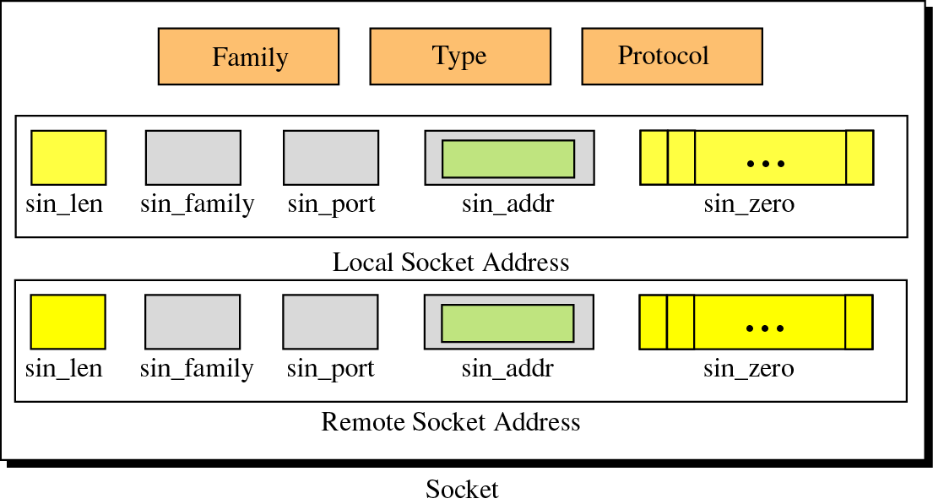
Socket Structure

Slide 13
Socket Families
Name Purpose
AF_UNIX, AF_LOCAL Local communication
AF_INET IPv4 Internet protocols
AF_INET6 IPv6 Internet protocols
AF_IPX IPX - Novell protocols
AF_NETLINK Kernel user interface device
AF_X25 ITU-T X.25 / ISO-8208 protocol
AF_AX25 Amateur radio AX.25 protocol
AF_ATMPVC Access to raw ATM PVCs
AF_APPLETALK Appletalk
AF_PACKET Low level packet interface

Slide 14
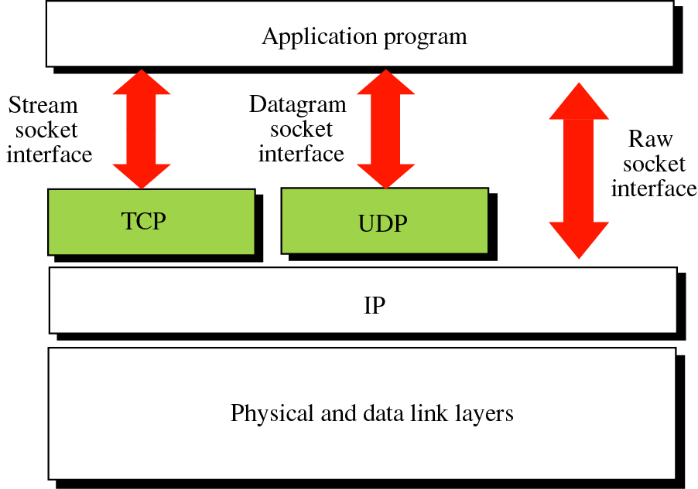
Socket Types

Slide 15
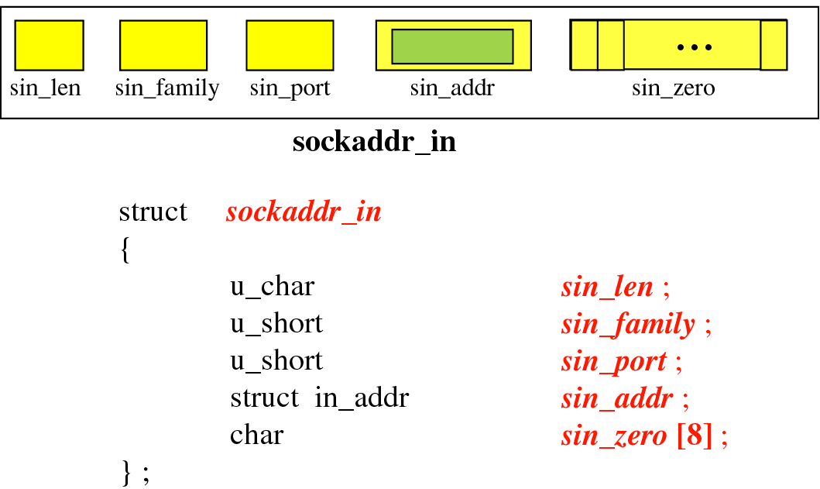
Socket address structure

Slide 16
Programming Client-Server in C
The steps involved in establishing a socket on the client side are as
follows:
  Create a socket with the socket() system call
  Connect the socket to the address of the server using the connect() system
  call
  Send and receive data using send() and recv() system calls.
The steps involved in establishing a socket on the server side are as
follows:
  Create a socket with the socket() system call
  Bind the socket to an address using the bind() system call. For a server
  socket on the Internet, an address consists of a port number on the host
  machine.
  Listen for connections with the listen() system call
  Accept a connection with the accept() system call. This call typically blocks
  until a client connects with the server.
  Send and receive data

Slide 17
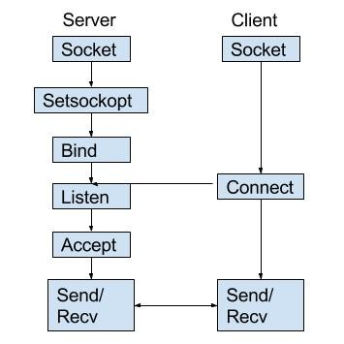
System calls and Flow

Slide 18
Programming TCP Client in C
Client.c
/* a structure to contain an internet address
defined in the include file <netinet/in.h> */
struct sockaddr_in {
short sin_family; /* should be AF_INET */
u_short sin_port;
struct in_addr sin_addr;
char sin_zero[8]; /* not used, must be zero */
};
struct in_addr {
unsigned long s_addr;
};
#include <stdio.h>
#include <sys/types.h>
#include <sys/socket.h>
#include <netinet/in.h>
#include <netdb.h>
void error(char *msg){ perror(msg); exit(0);}
int main(int argc, char *argv[]){
int sockfd, portno, n;
struct sockaddr_in serv_addr;
struct hostent *server;
char buffer[256];
if (argc < 3) {
fprintf(stderr,"usage %s hostname port\n", argv[0]);
exit(0);
}
portno = atoi(argv[2]);
sockfd = socket(AF_INET, SOCK_STREAM, IPPROTO_TCP);
if (sockfd < 0) error("ERROR opening socket");

Slide 19
Programming TCP Client in C
Client.c
Socket System Call – create an end point for communication
#include <sys/types.h>
#include <sys/socket.h>
int socket(int domain, int type, int protocol);
Returns a descriptor
domain: selects protocol family
e.g. PF_IPX, PF_X25, PF_APPLETALK
type: specifies communication semantics
e.g. SOCK_DGRAM, SOCK_RAW
protocol: specifies a particular protocol to be used
e.g. IPPROTO_UDP, IPPROTO_ICMP
#include <stdio.h>
#include <sys/types.h>
#include <sys/socket.h>
#include <netinet/in.h>
#include <netdb.h>
void error(char *msg){ perror(msg); exit(0);}
int main(int argc, char *argv[]){
int sockfd, portno, n;
struct sockaddr_in serv_addr;
struct hostent *server;
char buffer[256];
if (argc < 3) {
fprintf(stderr,"usage %s hostname port\n", argv[0]);
exit(0);
}
portno = atoi(argv[2]);
sockfd = socket(AF_INET, SOCK_STREAM, IPPROTO_TCP);
if (sockfd < 0) error("ERROR opening socket");

Slide 20
Programming TCP Client in C
Client.c
server = gethostbyname(argv[1]);
if (server == NULL) { fprintf(stderr,"ERROR, no such host\n"); exit(0); } bzero((char *) &serv_addr, sizeof(serv_addr));
serv_addr.sin_family = AF_INET;
bcopy((char *)server->h_addr, (char *)&serv_addr.sin_addr.s_addr
, server->h_length);
serv_addr.sin_port = htons(portno);
if (connect(sockfd,&serv_addr,sizeof(serv_addr)) < 0)
error("ERROR connecting");
printf("Please enter the message: ");
bzero(buffer,256); fgets(buffer,255,stdin);
n = send(sockfd,buffer,strlen(buffer),0);
if (n < 0) error("ERROR writing to socket");
bzero(buffer,256);
n = recv(sockfd,buffer,255,0);
if (n < 0)
error("ERROR reading from socket");
printf("%s\n",buffer);
close(sockfd);
return 0;
}
Send System Call – send a message to a socket
#include <sys/types.h>
#include <sys/socket.h>
int send( int s, const void *msg, size_t len,
int flags);
Returns number of characters sent on success
s: descriptor that must refer to a socket in connected state
msg: data that we want to send
len: length of data
flags: use default 0. MSG_OOB, MSG_DONTWAIT

Slide 21
Programming TCP Client in C
Client.c
server = gethostbyname(argv[1]);
if (server == NULL) { fprintf(stderr,"ERROR, no such host\n"); exit(0); } bzero((char *) &serv_addr, sizeof(serv_addr));
serv_addr.sin_family = AF_INET;
bcopy((char *)server->h_addr, (char *)&serv_addr.sin_addr.s_addr
, server->h_length);
serv_addr.sin_port = htons(portno);
if (connect(sockfd,&serv_addr,sizeof(serv_addr)) < 0)
error("ERROR connecting");
printf("Please enter the message: ");
bzero(buffer,256); fgets(buffer,255,stdin);
n = send(sockfd,buffer,strlen(buffer),0);
if (n < 0) error("ERROR writing to socket");
bzero(buffer,256);
n = recv(sockfd,buffer,255,0);
if (n < 0)
error("ERROR reading from socket");
printf("%s\n",buffer);
close(sockfd);
return 0;
}
Connect System Call – initiates a connection on a socket
#include <sys/types.h>
#include <sys/socket.h>
int connect( int sockfd,
const struct sockaddr *serv_addr,
socklen_t addrlen);
Returns 0 on success
sockfd: descriptor that must refer to a socket
serv_addr: address to which we want to connect
addrlen: length of serv_addr

Slide 22
Programming TCP Client in C
Client.c
server = gethostbyname(argv[1]);
if (server == NULL) { fprintf(stderr,"ERROR, no such host\n"); exit(0); } bzero((char *) &serv_addr, sizeof(serv_addr));
serv_addr.sin_family = AF_INET;
bcopy((char *)server->h_addr, (char *)&serv_addr.sin_addr.s_addr
, server->h_length);
serv_addr.sin_port = htons(portno);
if (connect(sockfd,&serv_addr,sizeof(serv_addr)) < 0)
error("ERROR connecting");
printf("Please enter the message: ");
bzero(buffer,256); fgets(buffer,255,stdin);
n = send(sockfd,buffer,strlen(buffer),0);
if (n < 0) error("ERROR writing to socket");
bzero(buffer,256);
n = recv(sockfd,buffer,255,0);
if (n < 0)
error("ERROR reading from socket");
printf("%s\n",buffer);
close(sockfd);
return 0;
}
Send System Call – send a message to a socket
#include <sys/types.h>
#include <sys/socket.h>
int send( int s, const void *msg, size_t len,
int flags);
Returns number of characters sent on success
s: descriptor that must refer to a socket in connected state
msg: data that we want to send
len: length of data
flags: use default 0. MSG_OOB, MSG_DONTWAIT

Slide 23
Programming TCP Client in C
Client.c
server = gethostbyname(argv[1]);
if (server == NULL) { fprintf(stderr,"ERROR, no such host\n"); exit(0); } bzero((char *) &serv_addr, sizeof(serv_addr));
serv_addr.sin_family = AF_INET;
bcopy((char *)server->h_addr, (char *)&serv_addr.sin_addr.s_addr
, server->h_length);
serv_addr.sin_port = htons(portno);
if (connect(sockfd,&serv_addr,sizeof(serv_addr)) < 0)
error("ERROR connecting");
printf("Please enter the message: ");
bzero(buffer,256); fgets(buffer,255,stdin);
n = send(sockfd,buffer,strlen(buffer),0);
if (n < 0) error("ERROR writing to socket");
bzero(buffer,256);
n = recv(sockfd,buffer,255,0);
if (n < 0)
error("ERROR reading from socket");
printf("%s\n",buffer);
close(sockfd);
return 0;
}
Recv System Call – receive a message from a socket
#include <sys/types.h>
#include <sys/socket.h>
int recv( int s, const void *buff, size_t len,
int flags);
Returns number of bytes received on success
s: descriptor that must refer to a socket in connected state
buff: data that we want to receive
len: length of data
flags: use default 0. MSG_OOB, MSG_DONTWAIT

Slide 24
Programming TCP Client in C
Client.c
server = gethostbyname(argv[1]);
if (server == NULL) { fprintf(stderr,"ERROR, no such host\n"); exit(0); } bzero((char *) &serv_addr, sizeof(serv_addr));
serv_addr.sin_family = AF_INET;
bcopy((char *)server->h_addr, (char *)&serv_addr.sin_addr.s_addr
, server->h_length);
serv_addr.sin_port = htons(portno);
if (connect(sockfd,&serv_addr,sizeof(serv_addr)) < 0)
error("ERROR connecting");
printf("Please enter the message: ");
bzero(buffer,256); fgets(buffer,255,stdin);
n = send(sockfd,buffer,strlen(buffer),0);
if (n < 0) error("ERROR writing to socket");
bzero(buffer,256);
n = recv(sockfd,buffer,255,0);
if (n < 0)
error("ERROR reading from socket");
printf("%s\n",buffer);
close(sockfd);
return 0;
}
Close System Call – close a socket descriptor
#include <unistd.h>
int close( int s);
Returns 0 on success
s: descriptor to be closed

Slide 25
Programming TCP Server in C
Server.c
#include <stdio.h>
#include <sys/types.h>
#include <sys/socket.h>
#include <netinet/in.h>
void error(char *msg){ perror(msg); exit(0);}
int main(int argc, char *argv[]){
int sockfd, newsockfd, portno, clilen;
char buffer[256];
struct sockaddr_in serv_addr, cli_addr;
int n;
if (argc < 2) { fprintf(stderr,"ERROR, no port provided\n"); exit(1); }
sockfd = socket(AF_INET, SOCK_STREAM, 0);
if (sockfd < 0) error("ERROR opening socket");
bzero((char *) &serv_addr, sizeof(serv_addr));
portno = atoi(argv[1]);
serv_addr.sin_family = AF_INET;
serv_addr.sin_addr.s_addr = INADDR_ANY;
serv_addr.sin_port = htons(portno);

Slide 26
Programming TCP Server in C
Server.c
if (bind(sockfd, (struct sockaddr *) &serv_addr, sizeof(serv_addr)) < 0) error("ERROR on binding");
listen(sockfd,5);
clilen = sizeof(cli_addr);
newsockfd = accept(sockfd, (struct sockaddr *) &cli_addr, &clilen);
if (newsockfd < 0) error("ERROR on accept");
bzero(buffer,256);
n = recv(newsockfd,buffer,255,0);
if (n < 0) error("ERROR reading from socket");
printf("Here is the message: %s\n",buffer);
n = send(newsockfd,"I got your message",18,0);
if (n < 0) error("ERROR writing to socket");
close(newsockfd);
close(sockfd);
return 0;
}
Bind System Call – bind a name to a socket
#include <sys/types.h>
#include <sys/socket.h>
int bind( int sockfd,
const struct sockaddr *serv_addr,
socklen_t addrlen);
Returns 0 on success
sockfd: descriptor that must refer to a socket
serv_addr: address to which we want to connect
addrlen: length of serv_addr

Slide 27
Programming TCP Server in C
Server.c
if (bind(sockfd, (struct sockaddr *) &serv_addr, sizeof(serv_addr)) < 0) error("ERROR on binding");
listen(sockfd,5);
clilen = sizeof(cli_addr);
newsockfd = accept(sockfd, (struct sockaddr *) &cli_addr, &clilen);
if (newsockfd < 0) error("ERROR on accept");
bzero(buffer,256);
n = recv(newsockfd,buffer,255,0);
if (n < 0) error("ERROR reading from socket");
printf("Here is the message: %s\n",buffer);
n = send(newsockfd,"I got your message",18,0);
if (n < 0) error("ERROR writing to socket");
close(newsockfd);
close(sockfd);
return 0;
}
Listen System Call – listen for connections on a socket
#include <sys/types.h>
#include <sys/socket.h>
int listen( int s, int backlog);
Returns 0 on success
s: descriptor that must refer to a socket
backlog: maximum length the queue for completely established sockets waiting to be accepted
addrlen: length of serv_addr

Slide 28
Programming TCP Server in C
Server.c
if (bind(sockfd, (struct sockaddr *) &serv_addr, sizeof(serv_addr)) < 0) error("ERROR on binding");
listen(sockfd,5);
clilen = sizeof(cli_addr);
newsockfd = accept(sockfd, (struct sockaddr *) &cli_addr, &clilen);
if (newsockfd < 0) error("ERROR on accept");
bzero(buffer,256);
n = recv(newsockfd,buffer,255,0);
if (n < 0) error("ERROR reading from socket");
printf("Here is the message: %s\n",buffer);
n = send(newsockfd,"I got your message",18,0);
if (n < 0) error("ERROR writing to socket");
close(newsockfd);
close(sockfd);
return 0;
}
Accept System Call – accepts a connection on a socket
#include <sys/types.h>
#include <sys/socket.h>
int accept( int sockfd,
const struct sockaddr *addr,
socklen_t addrlen);
Returns a non-negative descriptor on success
sockfd: descriptor that must refer to a socket
addr: filled with address of connecting entity
addrlen: length of addr

Slide 29
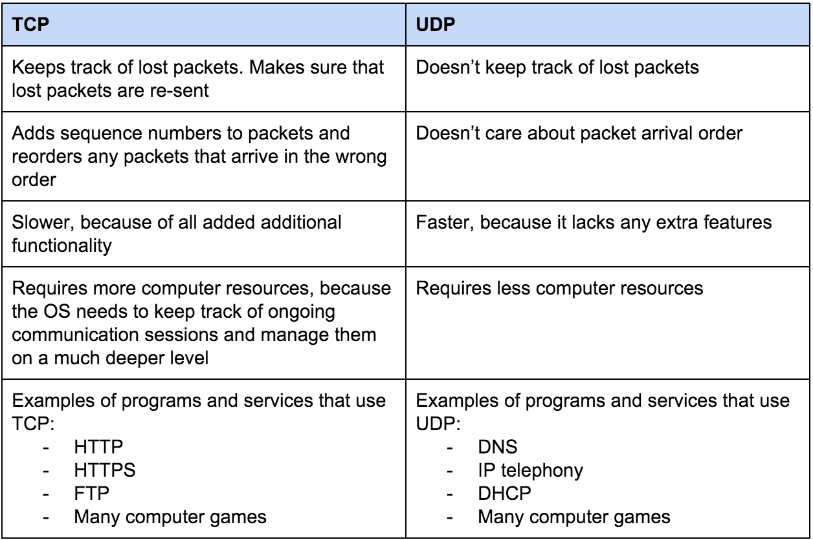
TCP vs. UDP

Slide 30
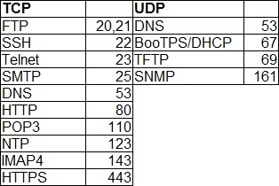

Slide 31
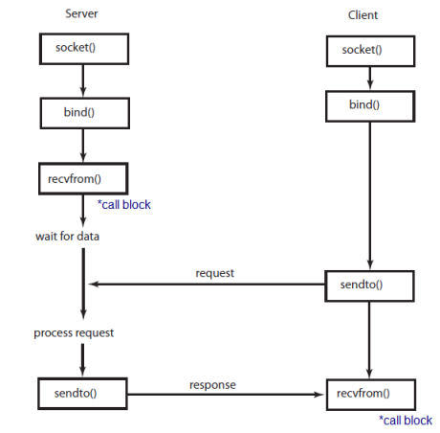
UDP Socket Programming

Slide 32
Programming UDP Client in C
The client code for a datagram socket client is the same as that for a
stream socket with the following differences.
  the socket system call has SOCK_DGRAM instead of SOCK_STREAM as its second argument & IPPROTO_UDP instead of IPPROTO_TCP as its third argument.
  there is no connect() system call
  instead of send() and recv(), the client uses sendto() and recvfrom()
sock = socket(AF_INET, SOCK_DGRAM, IPPROTO_UDP);
len = sizeof(struct sockaddr_in);
while (1) {
/* write */
n = sendto(sock,“Got your message\n",17, 0,(struct sockaddr *) &server, len);
f (n < 0) error("sendto");
/* read */
n = recvfrom(sock,buf,1024,0,(struct sockaddr *)&from, len); if (n < 0) error("recvfrom");
}

Slide 33
Programming UDP Server in C
Server code with a datagram socket is similar to the stream socket
code with following differences.
  Servers using datagram sockets do not use the listen() or the accept() system calls.
  After a socket has been bound to an address, the program calls recvfrom() to read a message or sendto() to send a message.
sock = socket(AF_INET, SOCK_DGRAM, IPPROTO_UDP);
len = sizeof(struct sockaddr_in);
while (1) {
/* read */
n = recvfrom(sock,buf,1024,0,(struct sockaddr *)&from, len); if (n < 0) error("recvfrom");
/* write */
n = sendto(sock,"Got your message\n",17, 0,(struct sockaddr *)&from, len);
f (n < 0) error("sendto");
}

Slide 34
Programming Client-Server in Java

Slide 35
Programming TCP Client-Server in Java
All the classes related to sockets are in the java.net package, so make
sure to import that package when you program sockets.
All the input/output stream classes are in the java.io package, include
this also
How to open a socket?
  If you are programming a client, then you would create an object of
  Socket class
  Machine name is the machine you are trying to open a connection to,
  PortNumber is the port (a number) on which the server you are trying to
  connect to is running. select one that is greater than 1,023! Why??
      Socket MyClient;
      try {
      MyClient = new Socket("Machine name", PortNumber);
      }
      catch (IOException e) {
      System.out.println(e);
      }

Slide 36
Programming TCP Client-Server in Java
If you are programming a server, then this is how you open a socket:
When implementing a server you also need to create a socket object from the ServerSocket in order to listen for and accept connections from clients.
      ServerSocket MyService;
      try {
      MyServerice = new ServerSocket(PortNumber);
      }
      catch (IOException e) {
      System.out.println(e);
      }
      Socket clientSocket = null;
      try {
      clientSocket = MyService.accept();
      }
      catch (IOException e) {
      System.out.println(e);
      }

Slide 37
Programming TCP Client-Server in Java
How to create an input stream?
  On the client side, you can use the DataInputStream class to create an
  input stream to receive response from the server:
  The class DataInputStream allows you to read lines of text and Java
  primitive data types in a portable way. It has methods such as read,
  readChar, readInt, readDouble, and readLine,.
  On the server side, you can use DataInputStream to receive input from
  the client:
      DataInputStream input;
      try {
      input = new DataInputStream(MyClient.getInputStream());
      }
      catch (IOException e) {
      System.out.println(e);
      }
      DataInputStream input;
      try {
      input = new DataInputStream(clientSocket.getInputStream());
      }
      catch (IOException e) {
      System.out.println(e);
      }

Slide 38
Programming TCP Client-Server in Java
How to create an output stream?
  On the client side, you can create an output stream to send information
  to the server socket using the class PrintStream or DataOutputStream
  of java.io:
  The class PrintStream has methods for displaying textual representation
  of Java primitive data types. Its write and println methods are important.
  Also, you may want to use the DataOutputStream:
  Many of its methods write a single Java primitive type to the output stream.
  The method writeBytes is a useful one.
      PrintStream output;
      try {
      output = new PrintStream(MyClient.getOutputStream());
      }
      catch (IOException e) {
      System.out.println(e);
      }
      DataOutputStream output;
      try {
      output = new DataOutputStream(MyClient.getOutputStream());
      }
      catch (IOException e) {
      System.out.println(e);
      }

Slide 39
Programming TCP Client-Server in Java
On the server side
  you can use the class PrintStream to send information to the client.
Note: You can use the class DataOutputStream as mentioned previously.
      PrintStream output;
      try {
      output = new PrintStream(clientSocket.getOutputStream());
      }
      catch (IOException e) {
      System.out.println(e);
      }

Slide 40
Programming TCP Client-Server in Java
How to close sockets?
  You should always close the output and input stream before you close
  the socket.
  On the client side:
  On the server side:
      try {
      output.close();
      input.close();
      MyClient.close();
      }
      catch (IOException e) {
      System.out.println(e);
      }
      try {
      output.close();
      input.close();
      clientSocket.close();
      MyService.close();
      }
      catch (IOException e) {
      System.out.println(e);
      }

Slide 41
Programming UDP Client-Server in Java
How to open a datagram socket?
  If you are programming a client, then you would create an object of
  DatagramSocket class
If you are programming a server, then this is how you open a socket:
      try {
      DatagramSocket socket = new DatagramSocket();
      }
      catch (IOException e) {
      System.out.println(e);
      }
      DatagramSocket socket = null;
      try {
      socket = new DatagramSocket(4445);
      }
      catch (IOException e) {
      System.out.println(e);
      }

Slide 42
Programming UDP Client-Server in Java
How to send/receive on Datagram sockets?
  On the client side, you can use the DatagramPacket class
  To send data
  To receive data
      byte[] buf = new byte[256];
      InetAddress address = InetAddress.getByName(args[0]);
      DatagramPacket packet = new DatagramPacket(buf, buf.length, address, 4445);
      socket.send(packet);
      packet = new DatagramPacket(buf, buf.length);
      socket.receive(packet);
      String received = new String(packet.getData());
      System.out.println(“Received from server: " + received);

Slide 43
Programming UDP Client-Server in Java
How to send/receive on Datagram sockets?
  On the Server side, you can use the DatagramPacket class
  To receive data
To send data
How to close a Datagram socket?
      byte[] buf = new byte[256];
      DatagramPacket packet = new DatagramPacket(buf, buf.length);
      socket.receive(packet);
      InetAddress address = packet.getAddress();
      int port = packet.getPort();
      packet = new DatagramPacket(buf, buf.length, address, port);
      socket.send(packet);
      socket.close();

